Slide 1

GROUP 8
HEALTHCARE Management system

Slide 2

AGENDA
Introduction
Final ERD
Problem Statement
Database Implementation
Key Objectives
Visualization Layers

Slide 3

INTRODUCTION
In the dynamic realm of healthcare, efficient management of information is paramount to ensuring the delivery of high-quality patient care and the streamlined operation of healthcare facilities.
The introduction of a robust Healthcare Management Database System represents a significant leap forward in optimizing the way healthcare data is collected, stored, and utilized.

Slide 4
PROBLEM STATEMENT
The project aims to address the inefficiencies and challenges in healthcare data management by developing a comprehensive database system. The system is dedicated to maintaining precise and secure records, covering comprehensive details such as patient profiles, doctor information, treatment records, as well as payment and billing particulars. The primary objectives include implementing efficient indexing strategies to facilitate fast data retrieval, creating User-Defined Functions (UDFs) for custom calculations, and employing Stored Procedures for managing complex database operations. The goal is to enhance the overall effectiveness of healthcare management, ensuring data integrity, security, and streamlined processes for improved patient care and administrative efficiency.

Slide 5
OBJECTIVES
Key Objectives
To manage dynamic interactions between patients, healthcare providers, and insurers, we have used event-driven programming.
To develop an integrated and efficient database for managing records and having it up to date.
To Utilize SQL triggers for dynamic data interactions based on the events.
To Optimize data retrieval using advanced SQL techniques using non-clustered indexes.
Implement stored procedures and UDFs for modular and secure data operations.
Ensure all data operations uphold the ACID properties.

Slide 6
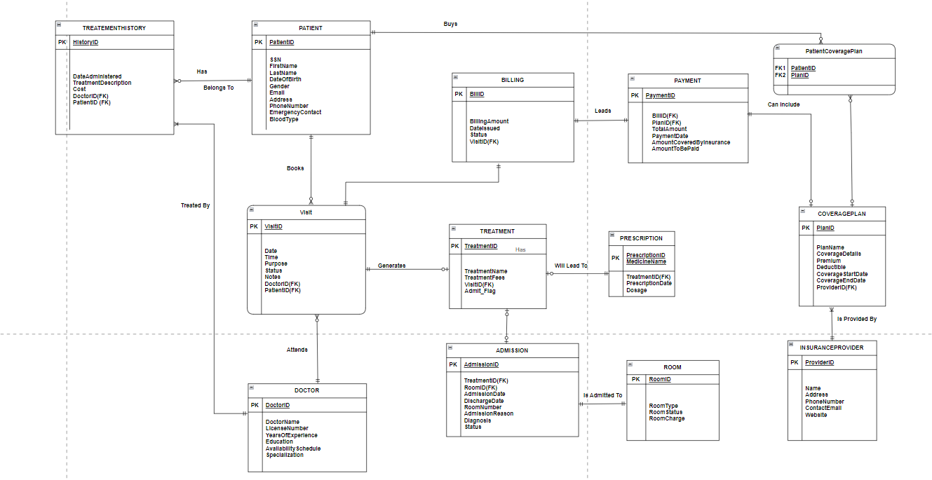
ER DIAGRAM

Slide 7
DATABASE IMPLEMENTATION
VIEWS : MonthlySummaryView, PatientTreatment , PatientPrescriptionTreatmentView
TRIGGERS : UpdateBillStatus , UpdateBillingOnDischarge
UDF : CalculateAmountToBePaid ,AmountCoveredByInsurance, GetTotalTreatmentCostForPatient
ENCRYPTION : On SSN field of Patient table is been encrypted.
STORED PROCEDURES:
Stored Procedure | Parameters
InsertAdmissionFromTreatment
InsertBillingData
InsertTreatmentHistory
InsertPaymentData
ScheduleVisit | @PatientID, @DoctorID,@VisitDate , @Purpose
InsertTreatment | @VisitID, @Admit_Flag, @TreatmentFees
CheckRoomAvailability | @VisitID

Slide 8
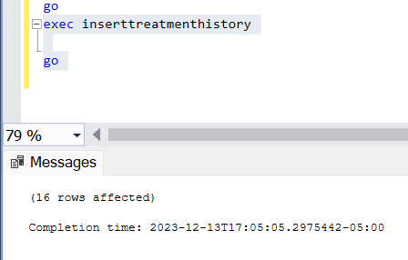
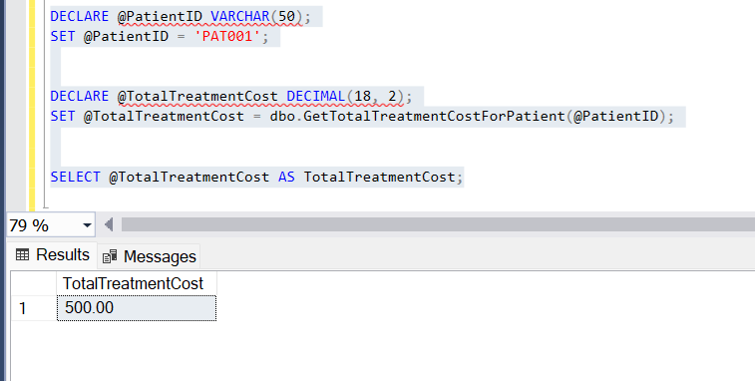
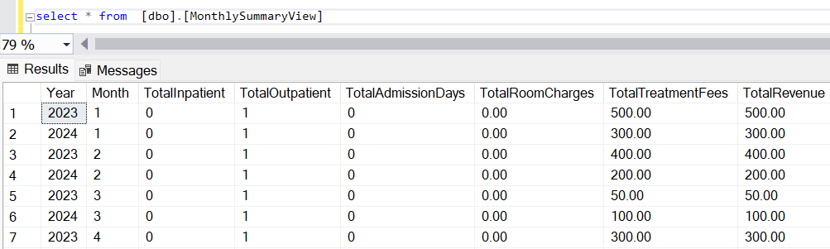
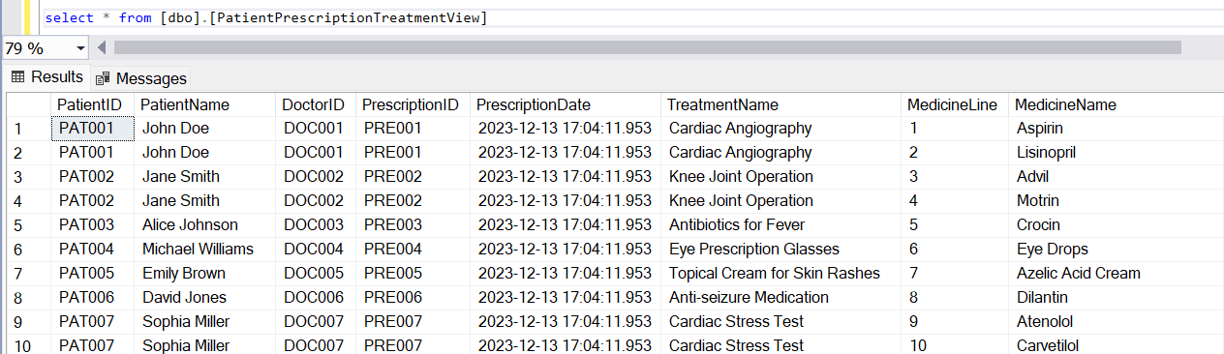
STORED PROCEDURE
USER DEFINED FUNCTIONS
VIEW

Slide 9

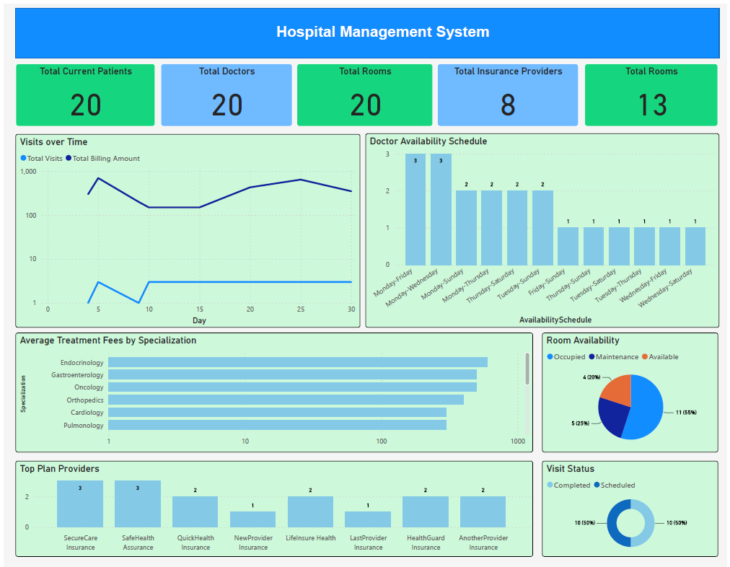
DATA VISUALIZATION

Slide 10
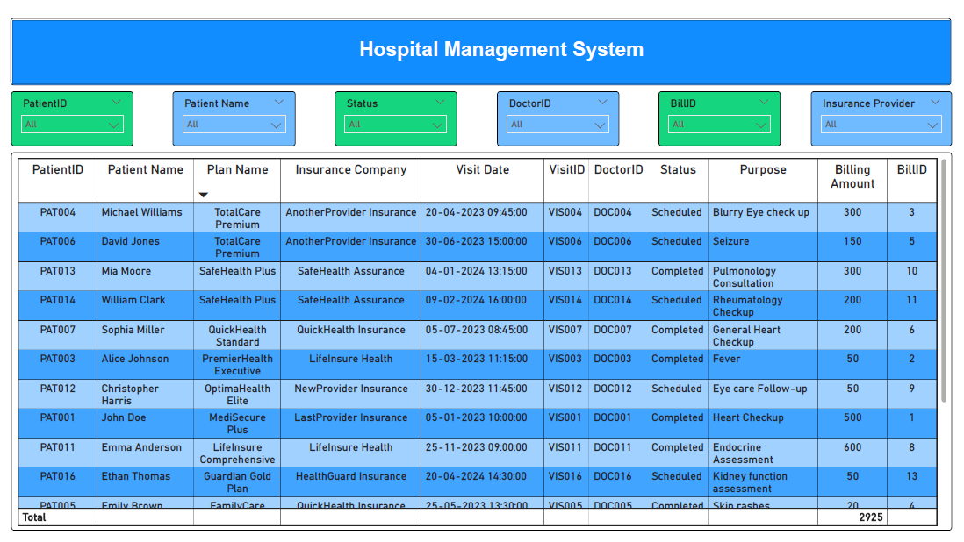

Slide 11
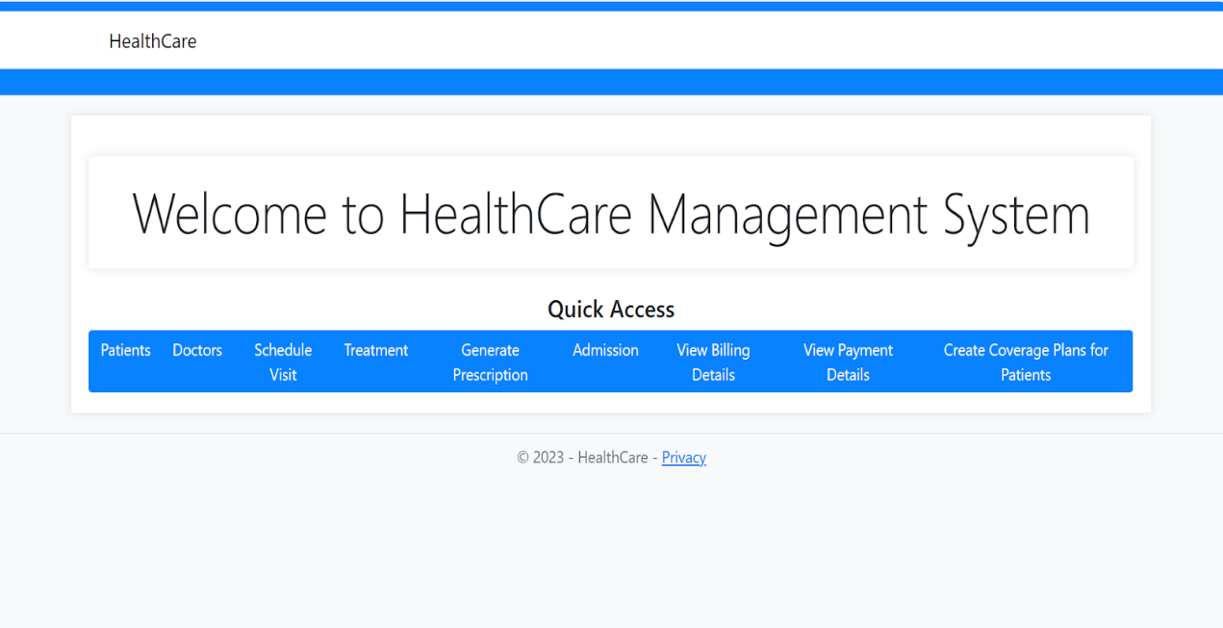
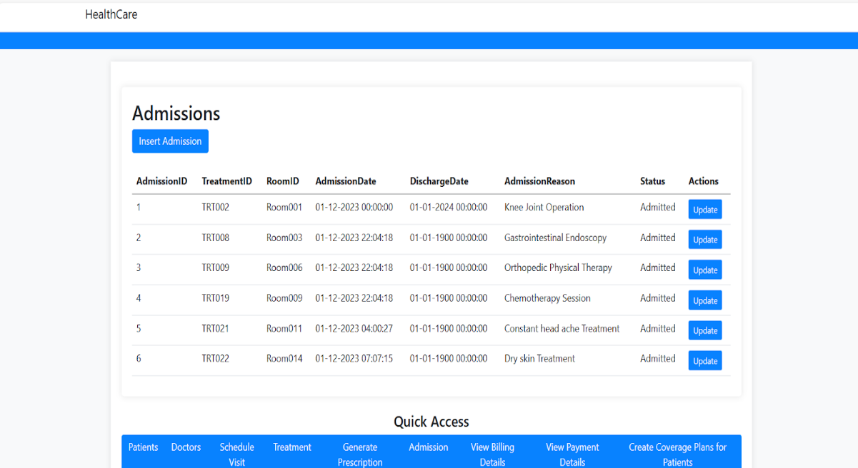
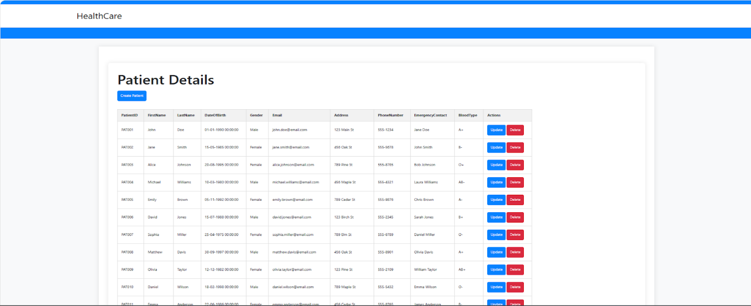
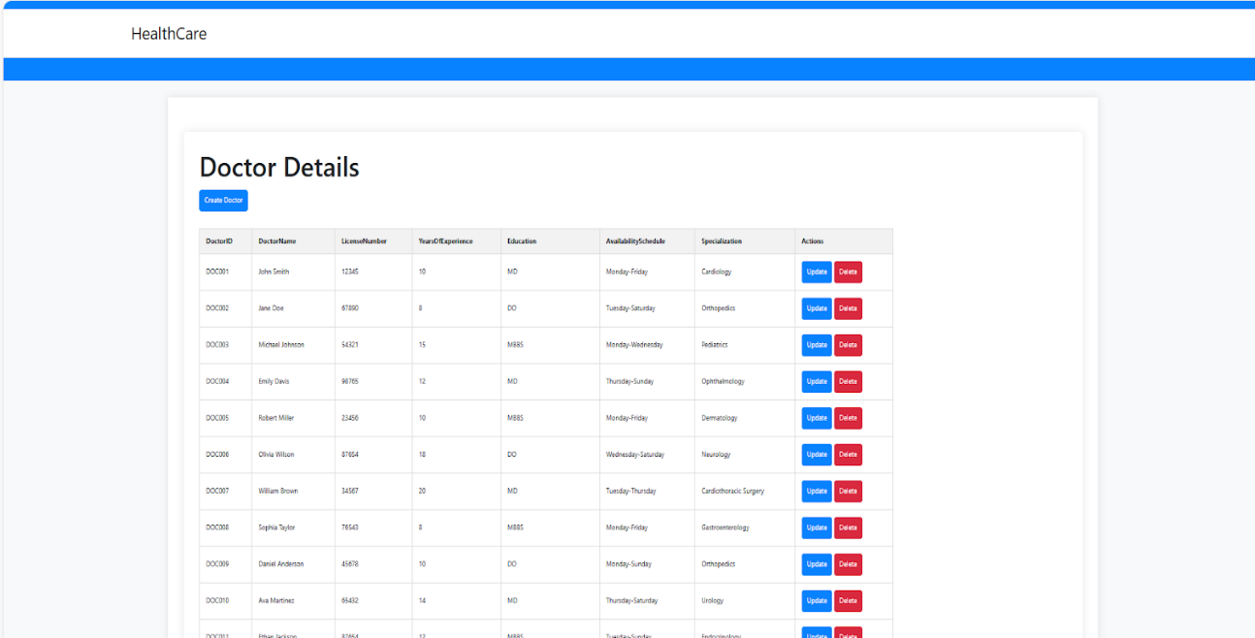
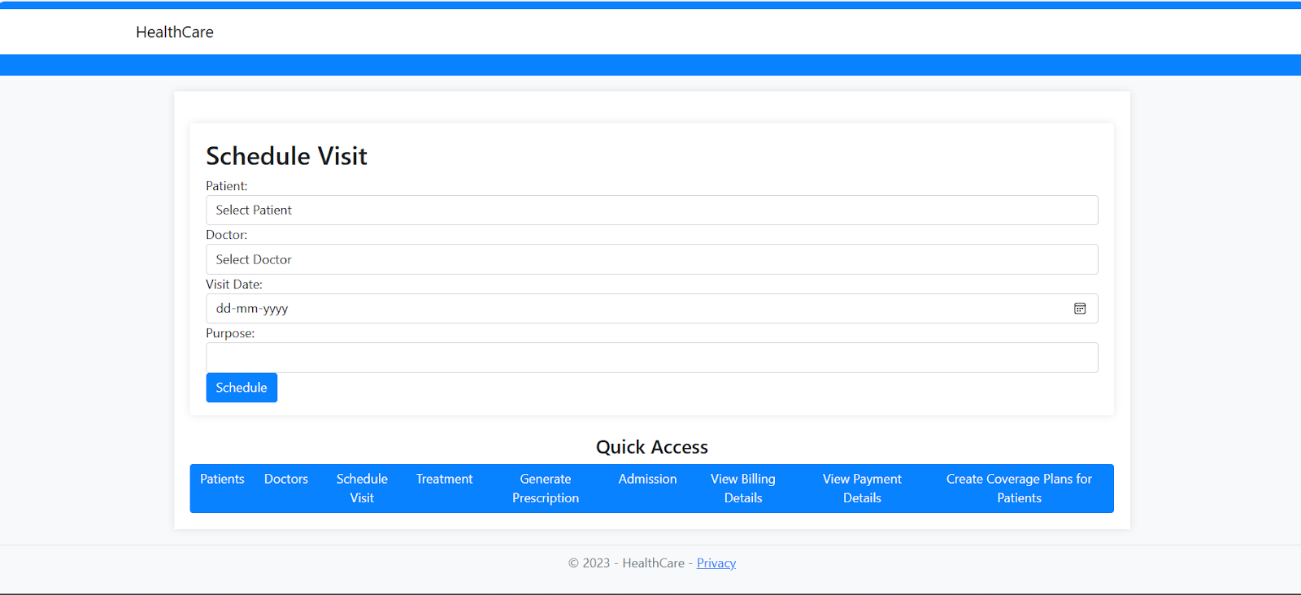
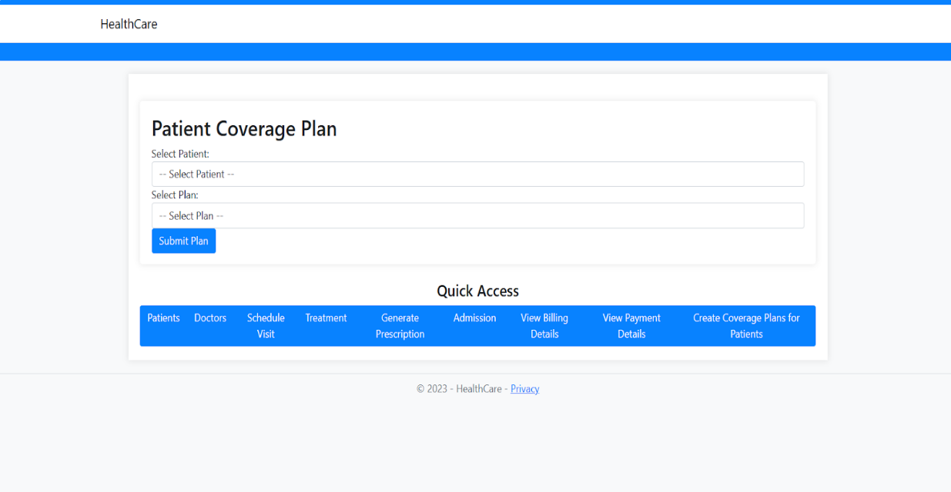
GUI

Slide 12
LIVE DEMO

